Slide 1
Jet Engine Lifecycle Survival Analysis and Remaining Useful Life (RUL) Prediction
Group 7: Siming Zhao, Yang Lu, Sijian Tan, Cheng Zhang

Slide 2


Motivations
Prognostics and health management (PHM): crucial field within the aerospace industry, instrumental in predicting the state of aircraft engines to prevent downtime and avoid failures.
Leveraging machine learning knowledge: enable facilitating a predictive maintenance approach based on the current state of the engines and enhances the reliability of aircraft operations.

Slide 3

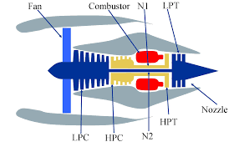
Dataset
The dataset employed in this project originates from the public repository managed by NASA's Prognostics Center of Excellence (CoE)
Specifically designed for asset degradation modelling, utilizing the Commercial Modular Aero-Propulsion System Simulation (C-MAPSS) framework.
Including four distinct datasets, representing a variety of operational conditions and fault modes.

Slide 4

Objectives
Utilize machine learning techniques to provide precise prediction of the survival probability and Remaining Useful Life (RUL) for specific engine types.
Analyze the engine's operational conditions and interpret data collected from different sensors
Provide a proactive maintenance approach for the industry

Slide 5
Data Description
The dataset from Kaggle includes the training, testing, and RUL data files for 4 different operation condition combination sets.
In training and testing data files, there are 26 columns, including:
Engine number | Sensor 9: Physical core speed (Nc, rpm)
Time in cycles | Sensor 10: Engine pressure ratio (epr, P50/P2)
Operation Condition 1: Altitude | Sensor 11: Static pressure at HPC outlet (Ps30, psia)
Operation Condition 2: Mach number | Sensor 12: Ratio of fuel flow to Ps30 (phi, pps/psi)
Operation Condition 3: Throttle resolver angle (TRA) | Sensor 13: Corrected fan speed (NRf, rpm)
Sensor 1: Total temperature at fan inlet (T2, R) | Sensor 14: Corrected fan speed (NRc, rpm)
Sensor 2: Total temperature at LPC outlet (T24, R) | Sensor 15: Bypass ratio (BPR)
Sensor 3: Total temperature at HPC outlet (T30, R) | Sensor 16: Burner fuel-air ratio (farB)
Sensor 4: Total Temperature LPT outlet (T50, R) | Sensor 17: Bleed Enthalpy (htBleed)
Sensor 5: Pressure at fan inlet (P2, psia) | Sensor 18: Demanded fan speed (Nf_dmd, rpm)
Sensor 6: Total pressure in bypass-duct (P15, psia) | Sensor 19: Demanded corrected FS (PCNfR_dmd, rpm)
Sensor 7: Total pressure at HPC outlet (P30, psia) | Sensor 20: HPT coolant bleed (W31, lbm/s)
Sensor 8: Physical fan speed (Nf, rpm) | Sensor 21: LPT coolant bleed (W32, lbm/s)

Slide 6
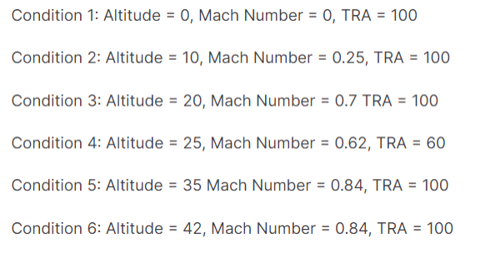
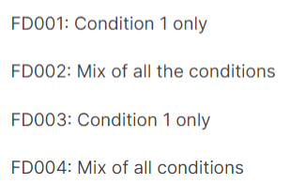
Data Description
There are 6 operation condition combinations:
And the 4 combination sets are:

Slide 7
Data Preprocessing
Check missing value in dataset
Feature selection
Variance thresholding: remove low-variance features, and reduce the dimensionality of the dataset
Random forest: effective in ranking features based on importance in making accurate predictions by the use of multiple decision trees; also in handling non-linear relationships
Combining these two balances the simplicity and computational efficiency, improve the effectiveness and performance of the model
Normalization
MinMaxScaler: transforms features by scaling them to a given range, typically between 0 and 1, but preserve the shape of the original distribution

Slide 8
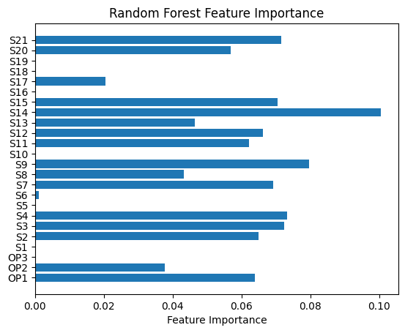
Feature Selection
FD001(Left Figure):
'S2', 'S3', 'S4', 'S7', 'S9', 'S11', 'S12', 'S14', 'S20'
FD002:
'OP1', 'OP2', 'S2', 'S3' , 'S4', 'S7', 'S8', 'S9', 'S11', 'S12', 'S13', 'S14', 'S15', 'S20', 'S21'
FD003:
'S2', 'S3', 'S4', 'S7', 'S8', 'S9','S11', 'S12', 'S13', 'S14', 'S20', 'S21'
FD004:
'OP1', 'OP2', 'S2', 'S3' , 'S4', 'S7', 'S8', 'S9', 'S11', 'S12', 'S13', 'S14', 'S15', 'S20', 'S21'

Slide 9
Cox Proportional Hazard Model

Slide 10
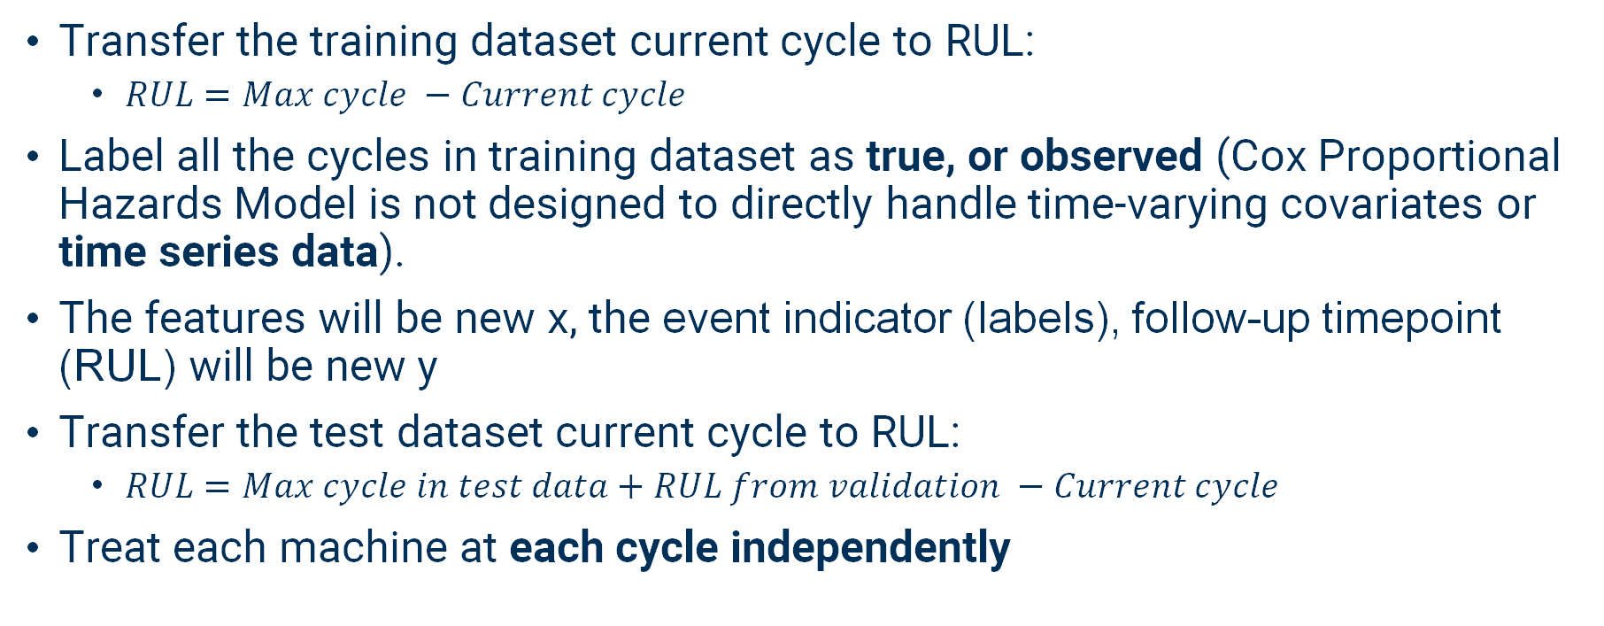
CoxPH Dataset Preprocessing
Transfer the training dataset current cycle to RUL:
$RUL=Max cycle −Current cycle$
Label all the cycles in training dataset as true, or observed (Cox Proportional Hazards Model is not designed to directly handle time-varying covariates or time series data).
The features will be new x, the event indicator (labels), follow-up timepoint (RUL) will be new y
Transfer the test dataset current cycle to RUL:
$RUL=Max cycle in test data+RUL from validation −Current cycle$
Treat each machine at each cycle independently

Slide 11
CoxPH Survival Analysis
Survival Analysis is a statistical method for analysing the length of time required for an event to occur. Survival Analysis is often referred to as time-to-event analysis
Time-to-Event Data: refers to a type of data that measures the time until a specific event of interest occurs. This event could be death in a medical study, failure of a machine component, or a customer unsubscribing from a service.
Time Variable: This is the primary variable of interest and represents the time until the occurrence of the event
Event Indicator: A binary variable indicating whether the event of interest has occurred or not
Right censored: Observations that have not experienced the event by the end of the observation period.
Our training datasets -- all the events have occurred. --> no censoring --> Event Indicator = True
Notes:
Notes: Mention that we tried manually create a right censored data by choosing an observed point. However this lead to challenges when predicting the survival curves for the testing data
The Cox Proportional-Hazards (coxPH) model assumes that the hazard ratios for covariates are constant over time. If no individuals in your training dataset experience the event after time = 200, the model hasn't seen any new information that would suggest a change in the hazard ratios beyond that point.
As a result, when you use the trained model to predict survival curves for your testing dataset, the predicted curves beyond time = 200 may not change because the model doesn't have evidence to suggest a change in hazard ratios.
It assumes the censoring should be independent from time. It will not affect the accuracy – chatgpt tells me
For censored observations, the model uses the information available up to the censoring time to contribute to the estimation of the hazard function.
For non-censored observations, the model uses the exact event times to estimate the hazard ratio and other parameters.

Slide 12
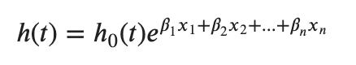
CoxPH Survival Analysis
Model: The model is used to estimate the hazard function, which describes how the hazard (instantaneous risk of an event) changes over time.
Non-parametric h₀(t): Baseline Hazard, representing the hazard at time t when all covariates are zero.
Parametric h(t): Characterization of how the hazard function changes based on the variables
Notes:
Uncensored meaning the event indicator = 1 – event has been observed occurred before time I
H(t) conditional probability of an event occurring at time 𝑡 given that the observed subject has not experienced the event at time 𝑡
Hazard Ratio: exp(β_{i}) -- a hazard ratio above 1 indicates a covariate that is positively associated with the event probability, and thus negatively associated with the length of survival.

Slide 13
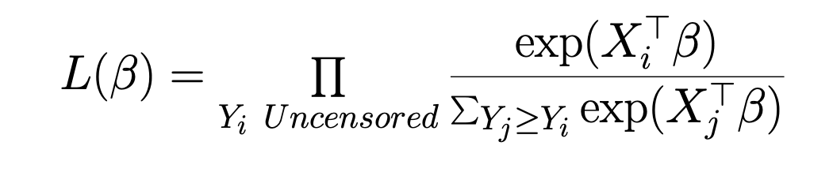
CoxPH Survival Analysis
Objective Function of CoxPH model:
Maximize Partial Likelihood
Notes:
The partial likelihood only considers the ordering of event times and discards the information about the baseline hazard function, making it a "partial" likelihood. Because it doesn’t make assumption on baseline hazard

Slide 14
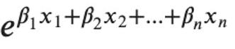
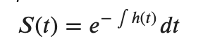
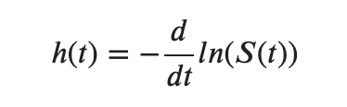
CoxPH Survival Analysis
Input:
X -> features
Y -> (event indicator, follow-up timepoint)
Output:
predict(X) -> Risk Scores
predict_cumulative_hazard_function(X)
predict_survival_function(X)
Notes:
Risk Scores: Individuals with higher risk scores are estimated to have a higher hazard or risk of experiencing the event
Hazard Function --> conditional probability of an event occurring at time 𝑡 given that the observed subject has not experienced the event at time 𝑡
Survival function--> The probability that the event S did not occur before the study observation period, t.
the probability that an event occurs after time 𝑡

Slide 15
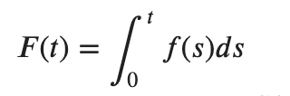
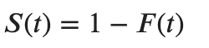
CoxPH Survival Analysis – Survival Function
Probability Density Function:
f(t) = P(T= t) (T random variable)
the probability that an event occurs at time 𝑡
Cumulative Distribution Function:
𝐹(𝑡)=𝑃(𝑇<=𝑡)
the probability that an event occurs before time 𝑡
Survival Distribution Function:
𝑆(𝑡)=𝑃(𝑇>𝑡)
the probability that an event occurs after time 𝑡
Notes:
Instead of predicting a single RUL value, we could get a survival distribution function for the object starting from their current cycle

Slide 16
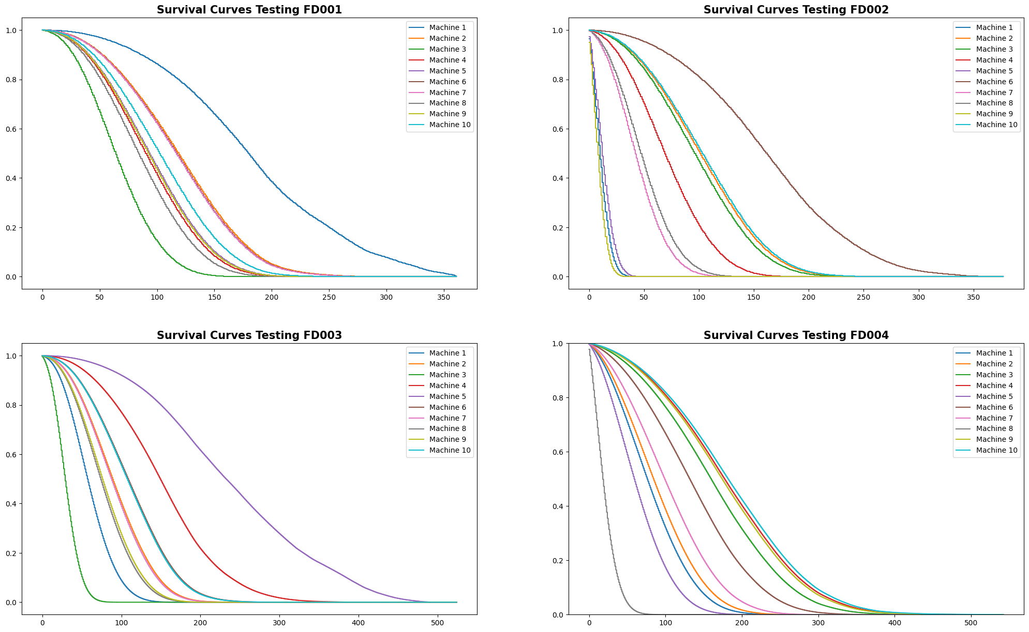
Survival Curves
Notes:
In the context of survival analysis, which deals with the time until an event of interest occurs (such as death or relapse), the concordance index measures the ability of a model to correctly order the survival times of pairs of individuals. A higher concordance index indicates better model performance. It ranges from 0 to 1, where 0.5 represents random chance (no predictive power), and 1 represents perfect concordance.
X axis is the time from the cycle at which the machine is – you can consider it as the RUL distribution.

Slide 17
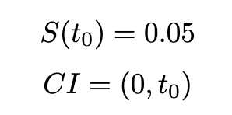
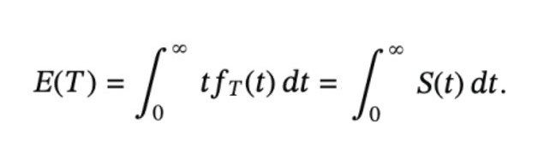
Evaluation of the Model on the testing datasets
Proportion: the proportion of the testing Remaining Useful Life (RUL) values that fall within the predicted 95% confidence interval of all my data points.
MSE: MSE of Predicted Expectation VS Testing RUL
Datasets | Proportion | MSE with Expectation | RMSE | RUL Mean of the Dataset
FD001 | 0.99 | 1346.08 | 36.69 | 75.52
FD002 | 0.97 | 1223.91 | 34.98 | 81.19
FD003 | 1.0 | 3348.64 | 57.87 | 75.32
FD004 | 0.99 | 2467.39 | 49.67 | 86.55

Slide 18
Advantages and Limitations of CoxPH
Advantages
Predict Hazard function and Survival function instead of a single value
Semi-Parametric Nature:
Not making assumptions about the shape of the hazard
Allows to adapt to different data patterns
Handling Censored Data
Our dataset failed to utilize this strength
Limitations
Our dataset is a time-series dataset which is not a perfect fit for the CoxPH.
The CoxPH model assumes that the hazard ratios for covariates are constant over time, implying a linear relationship between the covariate and the hazard function on the log scale.
We treated the datapoints of the same machine at different cycles independently while they are actually not.
Notes:
The CoxPH model assumes that the hazard ratios for covariates are constant over time. -- when talking about it mention other models
Random Forest Survival analysis can handle time varying effects naturally.
CoxPH is designed to handle censoring data but it could still handle non-censored data
The model assumes that the censoring process is independent of the failure process. The probability of an observation being censored is not related to the time it would take for that observation to experience the event (failure).

Slide 19
Long Short Term Memory Model

Slide 20
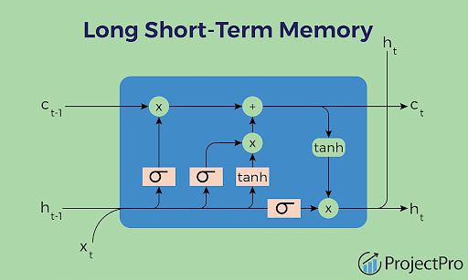
LSTM (Long Short-Term Memory) Introduction
Recurrent Neural Network (RNN) used in deep learning to process and make predictions on sequential data.
Overcome the limitations of traditional RNNs in handling long-term dependencies within data sequences.
Well-suited for survival analysis, model how risk factors evolve over time and how they influence the probability of an event (like failure or death) occurring.
Adaptability in dealing with censored data, accurately predicting time-to-event outcomes.
Notes:
Before we choose LSTM, we considered using RNN. However, RNN will has vanishing gradients, causing RNN is easily forget past information. Additionally, there is a problem of gradient explosion, where the effect of multiplying gradients during backpropagation results in an exponential growth of gradients. So RNN is not really good for large datasets. But LSTM can very good to solve this problem.

Slide 21
LSTM Structures
Cell state: central component of the LSTM, acting as a 'memory' of the network, runs straight down the entire chain of the network, allowing information to flow along it
Forget gate: decides what information should be discarded from the cell state.
Input gate: determines what new information will be added to the cell state.
Output gate: decides what the next hidden state should be, which includes the information that will be passed to the next LSTM cell.
Hidden state: output of the LSTM cell, passed to the next time step and influences the gates in the next cell
Notes:
Before we choose LSTM, we considered using RNN. However, RNN will has vanishing gradients, causing RNN is easily forget past information. Additionally, there is a problem of gradient explosion, where the effect of multiplying gradients during backpropagation results in an exponential growth of gradients. So RNN is not really good for large datasets. But LSTM can very good to solve this problem.

Slide 22
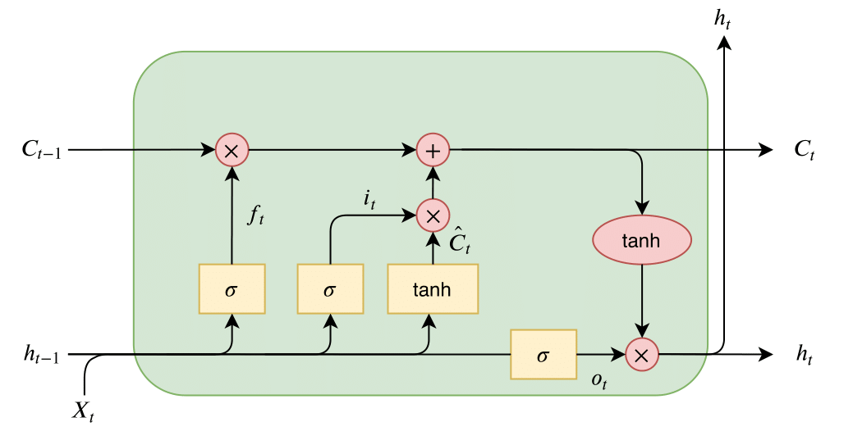
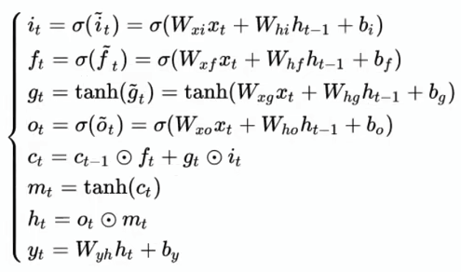
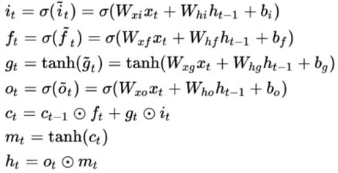
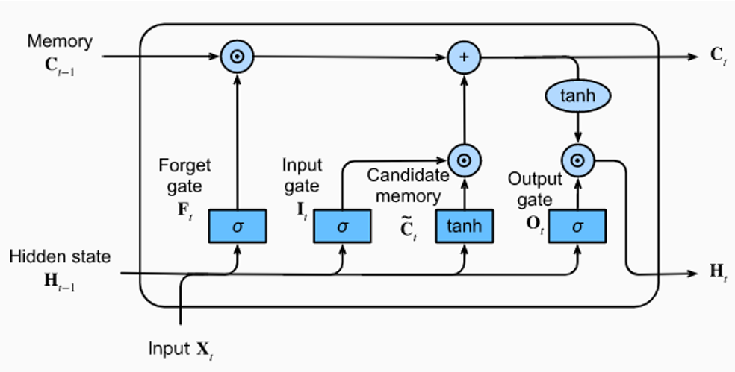
LSTM Governing Equations
Hadamard product
gt
mt
sigmoid
Hyperbolic tangent
Notes:
LSTM consists of three gates—forget gate, input gate, and output gate. On the left side above line, Ct−1 represents the long-term memory from the previous time step, ht−1 is the short-term memory from the previous time step, and Xt is the input for the current cell. Sigmoid functions is the activation functions for gates in LSTM.
The output of the forget gate is computed as the sigmoid of the sum of the forget gate weight matrix times Xt , the hidden state gate weight matrix multiplied by ht−1 , and plus the forget gate bias. Similar calculations apply to the other two gates. For the input gate is a little bit different, we can see the input gate involves a hidden cell, contributing to better handling of issues like gradient vanishing and explosion. The hyperbolic tangent function is to process gt , keeping the results within the range of 0 to 1 and reduce the risk of gradient explosion.
The next step involves a Hadamard product between ft and the long-term memory from the previous time step, and plus the Hadamard product with gt and it , the output is Ct . And the tanh(Ct) can gets mt , and use the Hadamard product of ot and mt gets ht.
In summary, the input gate, forget gate, and output gate empower LSTM to effectively manage long-term dependencies and reduce gradient challenges.

Slide 23
LSTM Prediction Procedures
Load Dataset & Check Null Values
Feature Selection
Dataset Normalization & RUL Calculation
Creating Sliding Window Sequences
LSTM Model & Implementation
Training and Validation
Prediction
Evaluation Metrics
Conclusion
Notes:
Before we choose LSTM, we considered using RNN. However, RNN will has vanishing gradients, causing RNN is easily forget past information. Additionally, there is a problem of gradient explosion, where the effect of multiplying gradients during backpropagation results in an exponential growth of gradients. So RNN is not really good for large datasets. But LSTM can very good to solve this problem.

Slide 24
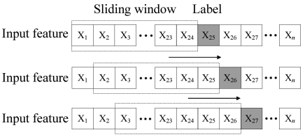
Creating Sliding Window Sequences
Sliding window prediction principle
Capture short-term dependencies
Sliding Windows allow the model to capture shorter-term dependencies. At each time step, the model can see a piece of past historical data, which helps to better learn and understand complex patterns in the time series.
Input data shape
The time series data can be transformed into a 3D array.(Number of Samples, Time Steps, Number of Features)
Source: https://ieeexplore.ieee.org/document/9366425
Notes:
Left hand side
Three important reason for sliding window

Slide 25
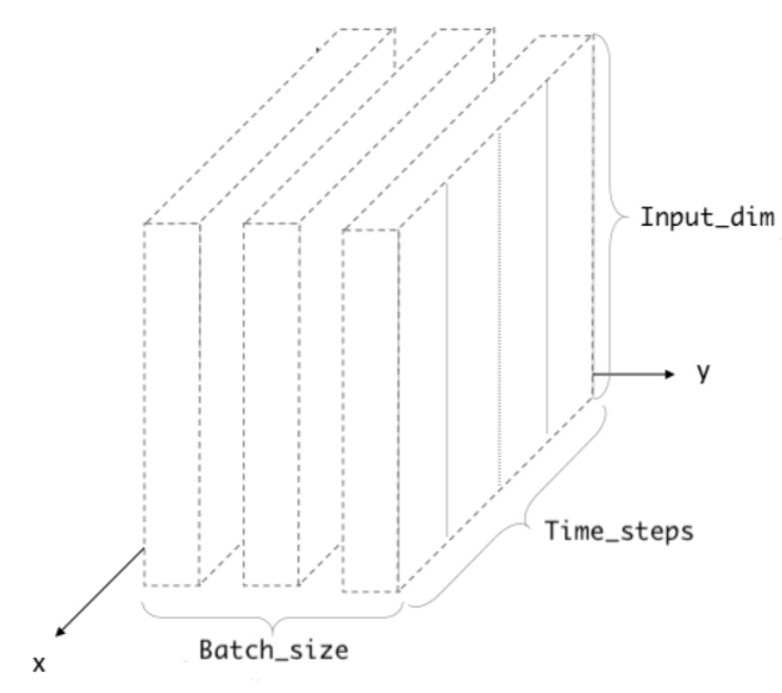


Training and Testing Dataset
 | FD001 | FD002 | FD003 | FD004
Train Dataset Shape | (19731, 10, 9) | (51419, 10, 15) | (23820, 10, 12) | (59008, 10, 15)
Train RUL Dataset Shape | (19731,) | (51419,) | (23820,) | (59008,)
Test Dataset Shape | (100, 10, 9) | (259, 10, 15) | (100, 10, 12) | (248, 10, 15)
Test RUL Dataset Shape | (100,) | (259,) | (100,) | (248,)
Feature_size

Slide 26
LSTM Model Build
LSTM Layer: An LSTM layer with 128 units, the input to the LSTM layer is 2D sequence data.
Input shape: (10, 9)
Dense Layer (fully connected): Takes the output of the LSTM layer and converts it into the final prediction.
Output: RUL

Slide 27
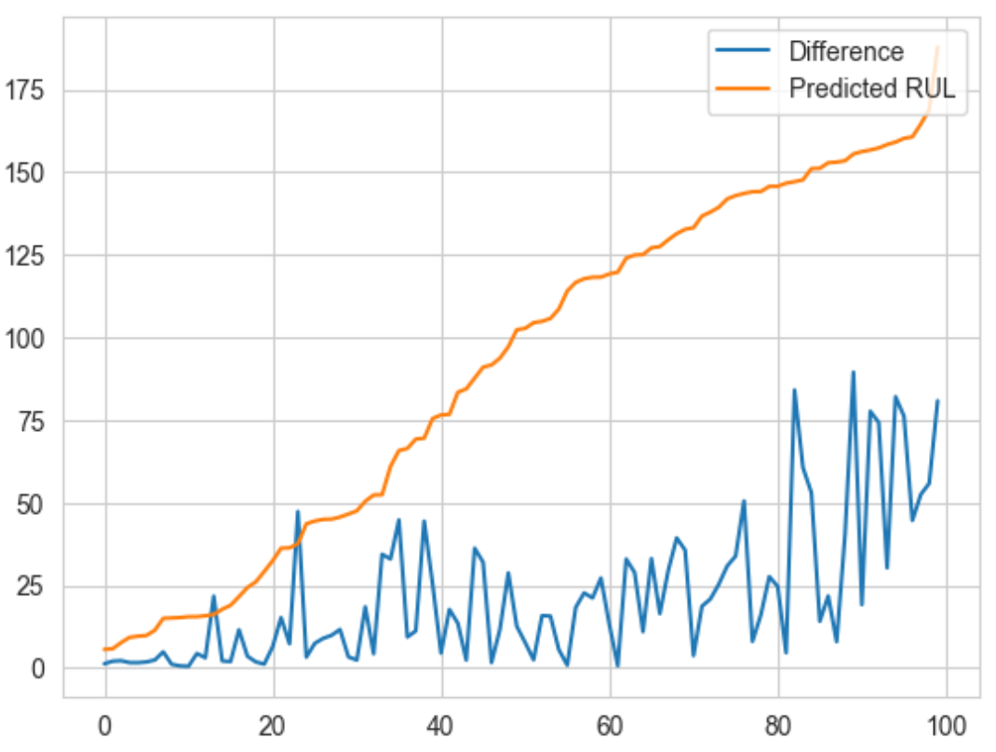
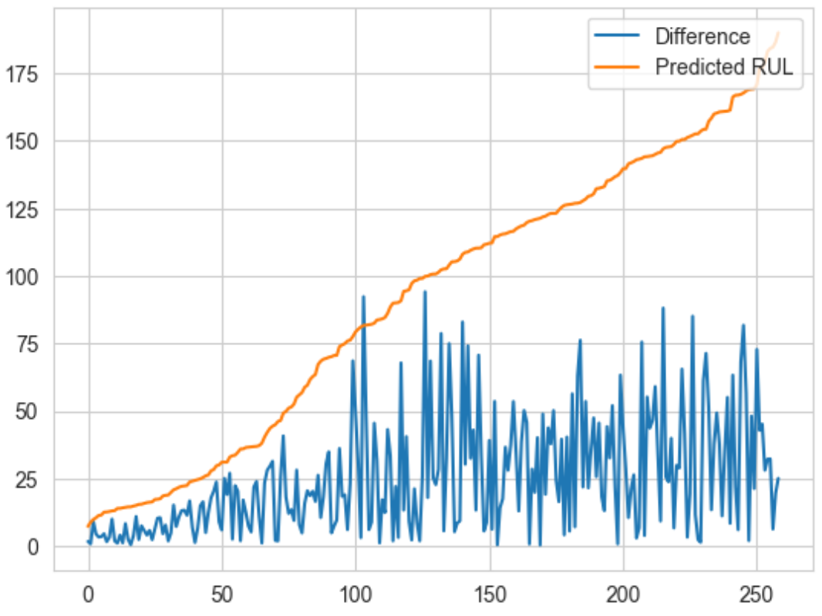
Prediction
Difference vs Predicted RUL (FD001)
Difference vs Predicted RUL (FD002)

Slide 28
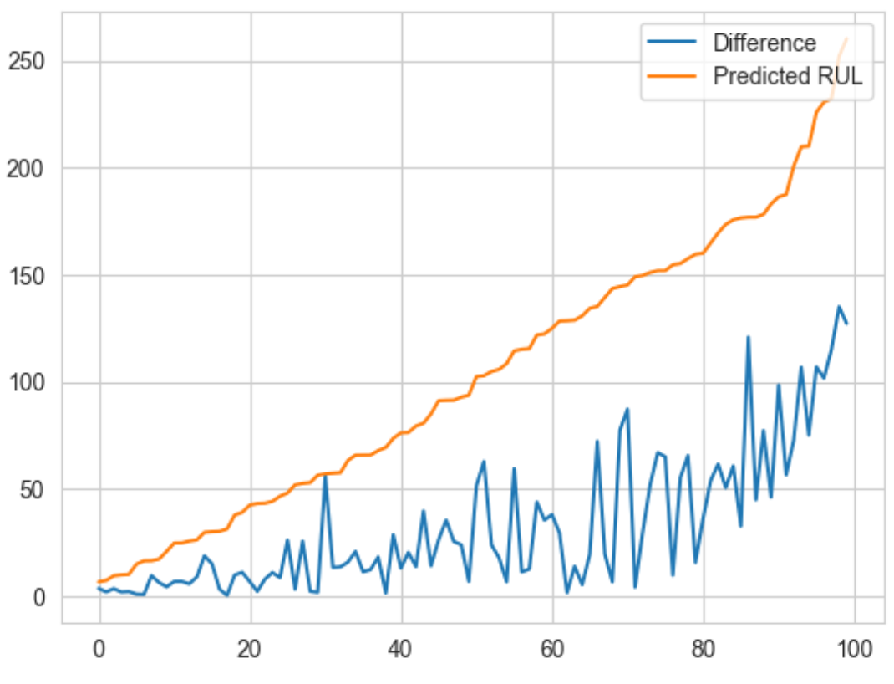
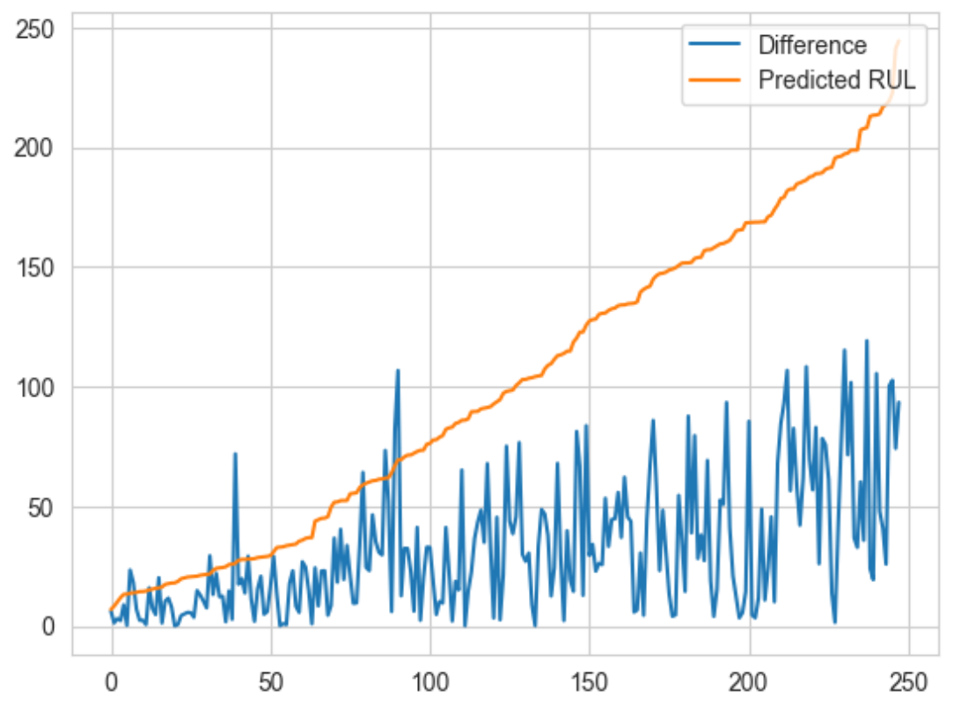
Prediction (cont.)
Difference vs Predicted RUL (FD003)
Difference vs Predicted RUL (FD004)

Slide 29
Evaluation Metrics
Our Model Performance
Baseline LSTM Performance
 | RMSE | R^2
FD001 | 28.943 | 0.515
FD002 | 31.585 | 0.655
FD003 | 36.137 | 0.238
FD004 | 39.674 | 0.471
 | RMSE | R^2
FD001 | 28.301 | 0.536
FD002 | 30.049 | 0.688
FD003 | 40.921 | 0.023
FD004 | 42.321 | 0.397
Source: https://www.kaggle.com/code/chiraggupta7410/turbo-jet-engine-predictive-maintainance-with-lstm/notebook
Notes:
R square explains how well the variance in the dependent variable could be explained by the independent variables

Slide 30
Conclusion
In this project, we:
Enhance predictive maintenance strategies by employing survival analysis to forecast an aircraft engine's survival function.
Concurrently leverage Long Short-Term Memory (LSTM) neural networks to estimate the engine's Remaining Useful Life (RUL).
These advanced predictive models enables the engine maintenance team to accurately determine the optimal scheduling for upcoming maintenance activities.
This is achieved by analyzing current sensor readings, thereby proactively prevent critical engine damage and ensuring operational efficiency.

Slide 31
Reference:
https://blog.klm.com/jet-engine-propulsion-the-comparison-of-power-between-a-car-and-an-aircraft/
https://global-engine.com/
https://gpm.nasa.gov/science-team/resources/nasa-logo
https://ntrs.nasa.gov/api/citations/20070034949/downloads/20070034949.pdf
https://blog.klm.com/jet-engine-maintenance-this-is-how-we-do-it/
https://www.kaggle.com/code/chiraggupta7410/turbo-jet-engine-predictive-maintainance-with-lstm/notebook
https://ieeexplore.ieee.org/stamp/stamp.jsp?tp=&arnumber=9366425

Slide 32
Thank you for listening

